Slide 1
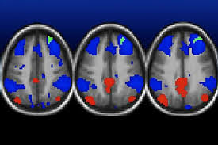
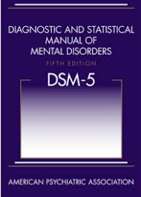
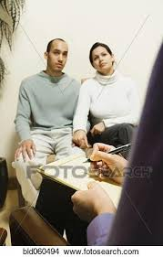
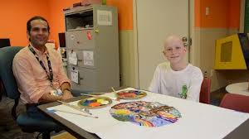
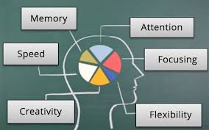
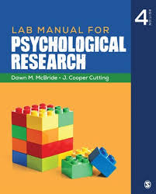
Clinical Program 2020
Bar Ilan University

Slide 2
The Clinical Mission
Effectively assessing and treating people coping with a variety of problems and challenges
Generating new knowledge about the human condition that would be part of the world-wide professional community

Slide 3
The Method
Extensive clinical training
Skill-based learning
Hands-on research training
Critical approach to empirical and clinical dilemmas
Comprehensive coverage of diverse treatment approaches
Pluralistic dialogue regarding major theoretical controversies

Slide 4
Unique Training Approach
Breadth of Content
From health to sickness
From infancy to geriatrics
From brain to narratives
Diversity of Approaches
Dynamic
CBT
Family/Systems
Integrative
Flexibility of Specialization
Your unique mix of interests
Intensive training
(almost) twice as many hours as requested by the professional committees
In-house Clinic
Close, intensive supervision by experts in the field
Research-based clinics
Innovative, state of the art-approaches
Small groups
7 students in in-house practica
15 student in electives
20 students in core courses

Slide 5
The Training Program (bird’s eye view)

Slide 6
Psychopathology
Required (core) courses
Adult Disorders
Disorders of Childhood and Adolescence
Neuropsychological Disorders
Electives (2 out of 6)
Infancy and Early Childhood Disorders
Attention Disorders
Autism
Topics in Trauma
Personality Pathology
Psychological sequelae of disability and chronic illness

Slide 7
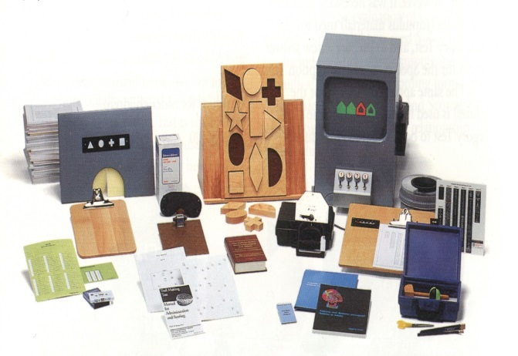
Diagnostics
Required (core) courses
Clinical Interview
Neurocognitive and neuropsychological assessment – Adult
Neurocognitive and neuropsychological assessment – Child
Personality
Diagnostic Integration (yearly)

Slide 8
Psychotherapy
Required (core) courses
Dynamic Psychotherapy (yearly)
Cognitive Behavioral Treatment (CBT, yearly)
Systems and Family Therapy
Integrative Psychotherapy in Illness, Disability, and Health
Electives (2 out of 6)
Schema Therapy
Couples Therapy
Therapy for Adolescence
Therapy for Children
Treatment of Serious Mental Illness
From Object-Relationships to Inter-Subjectivity

Slide 9
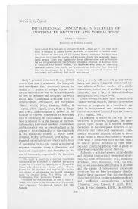
Research
Required (core) courses
Ethics
General Introduction to Statistics
Research Advancement Course
Electives (1 out of 3)
Qualitative Research Methods
Quantitative Research Methods – Advanced
Expert Guidance in Qualitative Research Methods

Slide 10
Clinical Practica
Required (core) courses
Dynamic Practica (Year 1, Yearly)
Advanced Practica (Year 2, 1 out of 6; Yearly)
Child Psychodynamic
Child Cognitive
Child Integrative
Adult Schema
Adult CBT
Adult Integrative
Outside Practica (Year 2, 2 days a week)
Multiple sites, multiple approaches

Slide 11
Who benefits most from our program?
People who like diversity of ideas
People who enjoy and value research
People who are ready to invest 50 hours a week for 24 months
People who find our research labs exciting

Slide 12
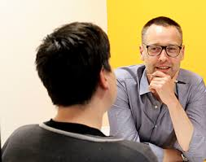
The Admission Process
Forms
Group interview
Clinical-abilities assessment interview
Research-interest matching interview

Slide 13
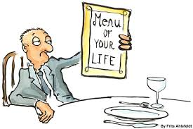
A PhD or a Masters?
Masters if
you are planning on doing mostly clinical work after graduation
you want to reach financial independence sooner rather than later
PhD if
you have a passion for research
you want to advance the field of psychology
you have a specific professional goal (academia, expert clinic etc)
you found a lab/advisor with whom you work well together
you want to spend the next 6 years working on your research

Slide 14
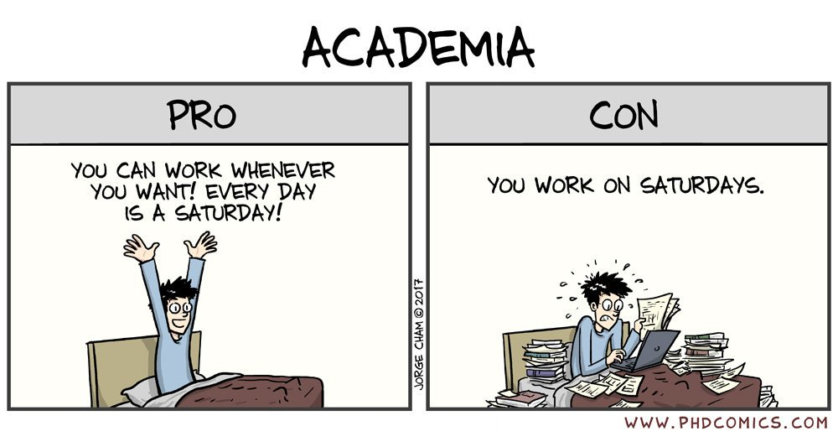
A PhD or a Masters?

Slide 15
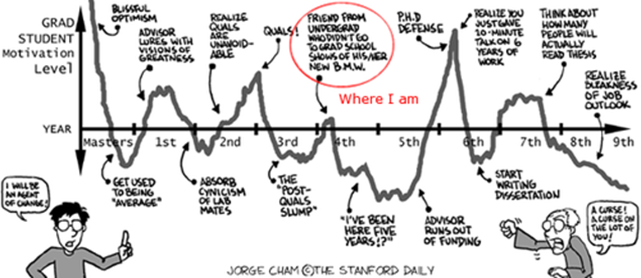
The Total Professional Journey
MA – 2 years (frequently 3+ years)
Internship 4+ years (half-time)
Licensing exam (1 year post internship)
------------------------------------------------------
Time for licensure:
MA: 7– 9 years
PhD: 8-10 years

Slide 17
